Slide 1
W4111 – Introduction to Databases Section 002, Spring 2024 Lecture 3: ER, Relational, SQL (II)
Away from office hours for a few minutes.
© Donald F. Ferguson, 2024

Slide 2
W4111 – Introduction to Databases Section 002, Spring 2024 Lecture 3: ER, Relational, SQL (II)
© Donald F. Ferguson, 2024

Slide 3
W4111 – Introduction to Databases Section 002, Spring 2024 Lecture 3: ER, Relational, SQL (II)
We will start in a couple of minutes.
© Donald F. Ferguson, 2024

Slide 4

Contents
4 | COMS W4111_002_2024_1: Lecture 3: ER, Relational, SQL (II) © Donald F. Ferguson, 2024

Slide 5
Contents
Introduction: Status updates
ER (Diagram) Modeling – More Complex Scenarios
The Relational Model and Algebra Continued (Chapter 2)
SQL Continued (Chapter 3, 4, 5)
Project Examples:
Web Applications and REST
Data Engineering and Visualization
Covered

Slide 6
Introduction
6 | COMS W4111_002_2024_1: Lecture 3: ER, Relational, SQL (II) © Donald F. Ferguson, 2024

Slide 7
Status Updates

Slide 8
Database design, Entity-Relationship Model (Part 2)
8 | COMS W4111_002_2024_1: Lecture 3: ER, Relational, SQL (II) © Donald F. Ferguson, 2024

Slide 9

More Complex Relationships
9 | COMS W4111_002_2024_1: Lecture 2: ER, Relational, SQL (II) © Donald F. Ferguson, 2024

Slide 10
Relationship Sets (Cont.)
Covered
An attribute can also be associated with a relationship set.
For instance, the advisor relationship set between entity sets instructor and student may have the attribute date which tracks when the student started being associated with the advisor

Slide 11
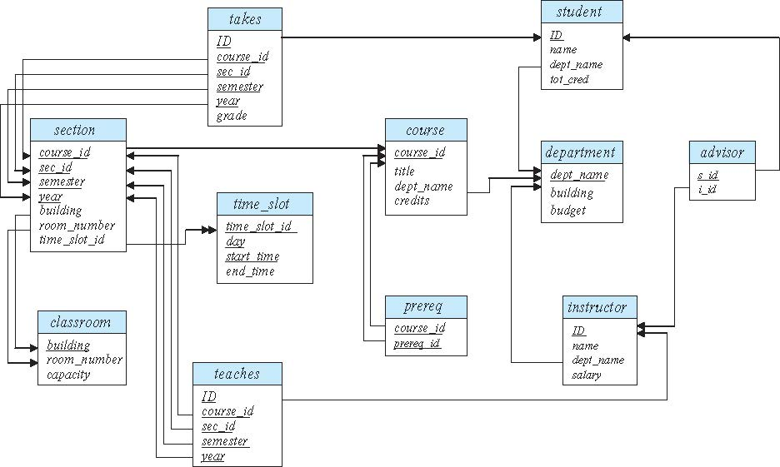
Schema Diagram for University Database
Covered

Slide 12
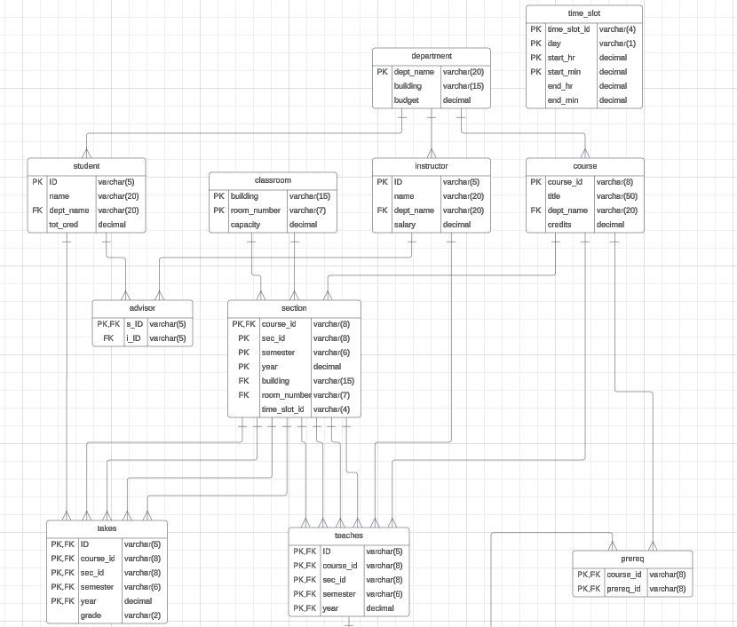
Some Observations
Reverse engineering seems to have made some mistakes.
But, notice that sometimes:
Relationship are foreign keys, e.g. Section-Classroom
Are something else, e.g. Advisor
This something else is called and Associative Entity.
SQL requires and Associative Entity if
The relationship is many-to-many.
There are properties on the relationships.
Covered

Slide 13
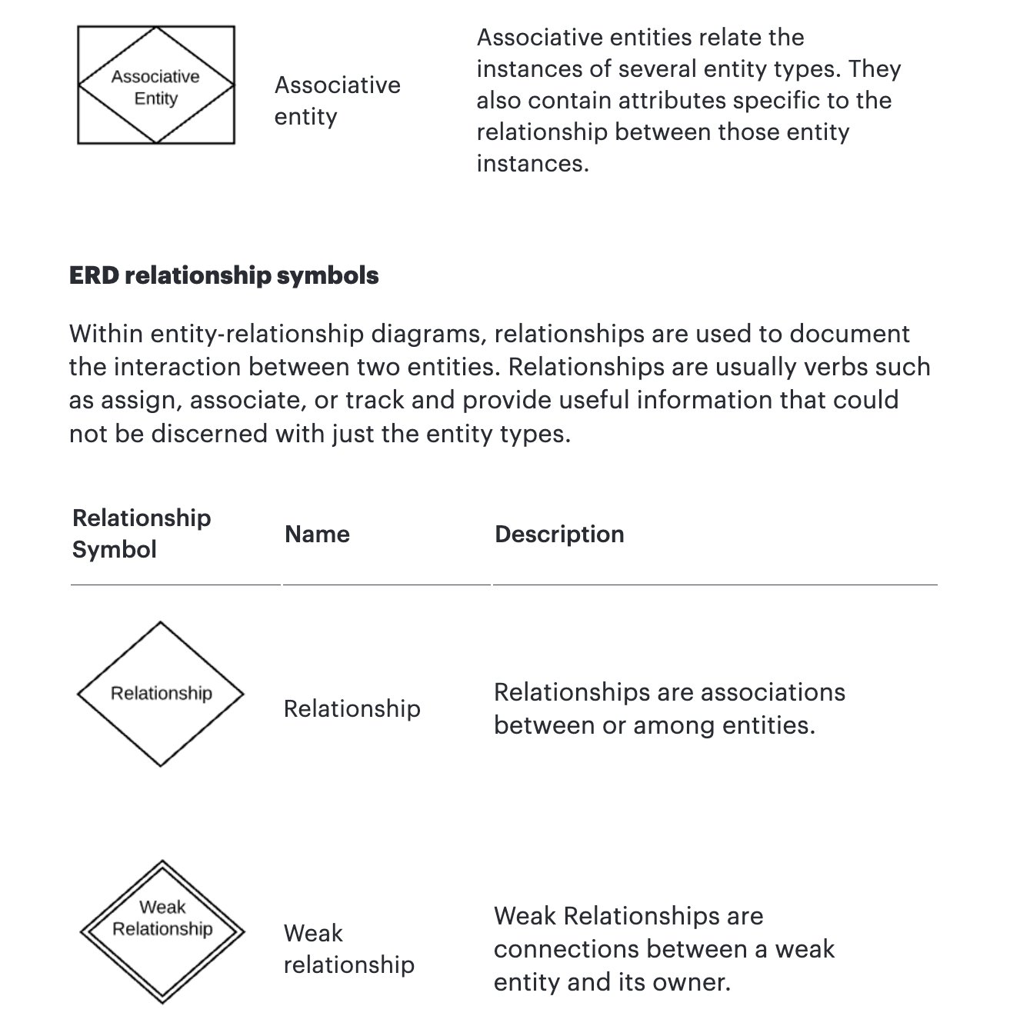
Associative Entity
The ER model represents “associations/relationships” as
First class “things”
That are different from “entities.”
The SQL model does not have “relationships” or associations as first-class types. You have
Tables
Columns
Keys
Constraints
… …
You can implement some “relationships” using foreign keys. Others require something more complex – an associative entity.
Covered

Slide 14
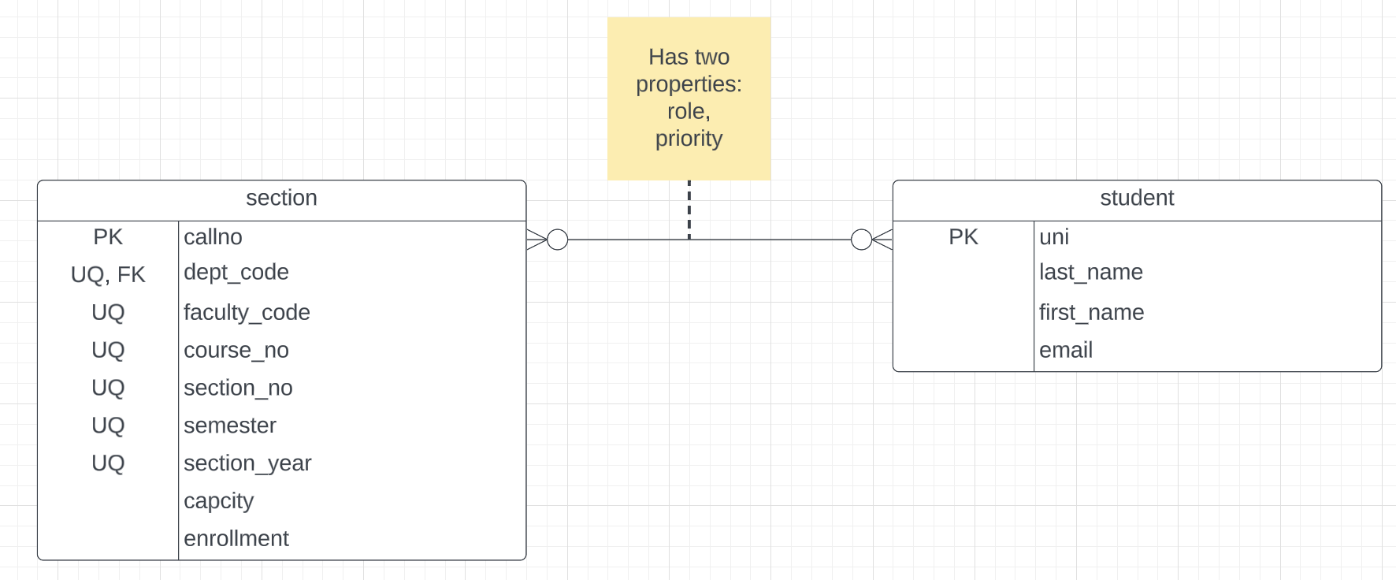
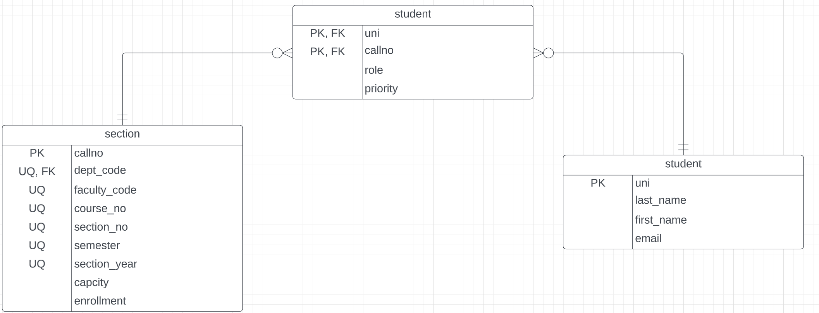
Associative Entity
“An associative entity is a term used in relational and entity–relationship theory. A relational database requires the implementation of a base relation (or base table) to resolve many-to-many relationships. A base relation representing this kind of entity is called, informally, an associative table.” (https://en.wikipedia.org/wiki/Associative_entity)
Consider Students – Sections:
This is many-to-many. There is no way to implement in SQL. You see this in the Advises table in the sample database.
The “relationship/association” has properties that are not attributes of the connected entities.
Covered
SQL Realization
Switch to notebook diagram.

Slide 15
Relationship Sets with Attributes
Covered

Slide 16
Roles
Covered
Entity sets of a relationship need not be distinct
Each occurrence of an entity set plays a “role” in the relationship
The labels “course_id” and “prereq_id” are called roles.

Slide 17
Degree of a Relationship Set
Covered
Binary relationship
involve two entity sets (or degree two).
most relationship sets in a database system are binary.
Relationships between more than two entity sets are rare. Most relationships are binary. (More on this later.)
Example: students work on research projects under the guidance of an instructor.
relationship proj_guide is a ternary relationship between instructor, student, and project

Slide 18
Non-binary Relationship Sets
Covered
Most relationship sets are binary
There are occasions when it is more convenient to represent relationships as non-binary.
E-R Diagram with a Ternary Relationship

Slide 19
Mapping Cardinality Constraints
Covered
Express the number of entities to which another entity can be associated via a relationship set.
Most useful in describing binary relationship sets.
For a binary relationship set the mapping cardinality must be one of the following types:
One to one
One to many
Many to one
Many to many

Slide 20
Apply to –
Game of Thrones https://github.com/jeffreylancaster/game-of-thrones ~/Dropbox/000/000-Data/GoT
20 | COMS W4111_002_2024_1: Lecture 2: ER, Relational, SQL (II) © Donald F. Ferguson, 2024

Slide 21
Game of Thrones
Bottom-Up Data Mapping:
“Nouns” usually map to Entity/Entity Set.
Nouns inside other nouns often map to:
Attribute
Relationship
Verbs often map to relationships.
Adjectives usually map to properties.
We will start with a subset of the information:
Game of Thrones:
Episodes
Characters
IMDB:
names_basics
title_basics
Entities Sets
Character
Season
Episode
Scene
Location, Sublocation
... ...
Relationships
Character – Scene
Character – Character (e.g. KilledBy)
Season – IMDB Title
Character – IMDB Name
... ...

Slide 22
Game of Thrones
Bottom-Up Data Mapping:
“Nouns” usually map to Entity/Entity Set.
Nouns inside other nouns often map to:
Attribute
Relationship
Verbs often map to relationships.
Adjectives usually map to properties.
We will start with a subset of the information:
Game of Thrones:
Episodes
Characters
IMDB:
names_basics
title_basics
Entities Sets
Character
Season
Episode
Scene
Location, Sublocation
... ...
Relationships
Character – Scene
Character – Character (e.g. KilledBy)
Season – IMDB Title
Character – IMDB Name
... ...
IMDB: https://developer.imdb.com/non-commercial-datasets/
Do not download.
Despite being “tiny” compared to the reall world.
The datasets are too big for most laptops.
Game of Thrones: https://github.com/jeffreylancaster/game-of-thrones

Slide 23
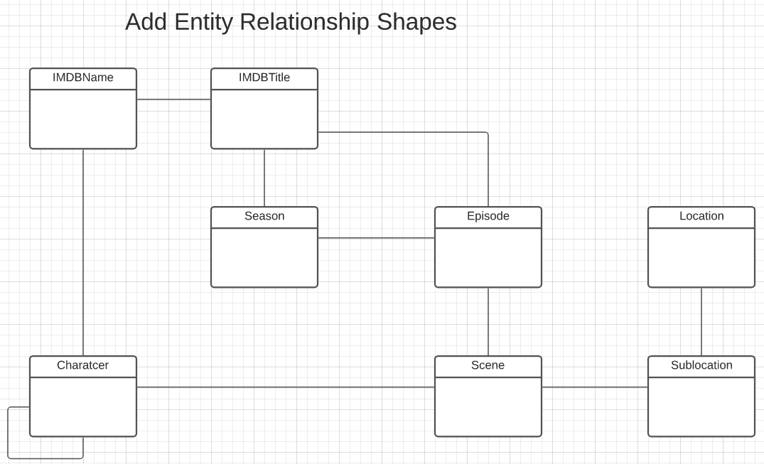
Game of Thrones – Conceptual Model
Add shapes in Lucidchart ...
With a little
Data exploration
Common sense
Judgment/experience
I came to this conceptual model.
Attributes unspecified
Relationship required/cardinality unspecified.
A little more exploration is needed.

Slide 24
Game of Thrones – Conceptual Model
Add shapes in Lucidchart ...
With a little
Data exploration
Common sense
Judgment/experience
I came to this conceptual model.
Attributes unspecified
Relationship required/cardinality unspecified.
A little more exploration is needed.
Show JSON files and explain.
Draw diagrams in Lucidchart for
GoT: character, season, episode, scene and the relationships.
IMDB: namebasic, titles, knownFor corrected, titlePrincipals, etc.
Loading this data into relational is a bear.
GoT:
The data is nested document format.
Relational is tables.
It is doable but requires code and pipelines.
I will give you the uncleaned up relational for HW2
IMDB:
Datasets are very large for a personal/laptop.
Many non-atomic columns.
/Users/donaldferguson/Dropbox/000/000-A-Current-Examples/IMDB_GOT_Processing

Slide 25
Relation Model and Algebra
25 | COMS W4111_002_2024_1: Lecture 3: ER, Relational, SQL (II) © Donald F. Ferguson, 2024

Slide 26
Assignment Rename
26 | COMS W4111_002_2024_1: Lecture 2: ER, Relational, SQL (II) © Donald F. Ferguson, 2024

Slide 27
The Assignment Operation
Covered
It is convenient at times to write a relational-algebra expression by assigning parts of it to temporary relation variables.
The assignment operation is denoted by ← and works like assignment in a programming language.
Example: Find all instructor in the “Physics” and Music department. Physics ← σ _{dept_name=“Physics”} (instructor)
Music ← σ _{dept_name=“Music”} (instructor)
Physics ∪ Music
With the assignment operation, a query can be written as a sequential program consisting of a series of assignments followed by an expression whose value is displayed as the result of the query.

Slide 28
Other Operators Fun with JOIN
28 | COMS W4111_002_2024_1: Lecture 2: ER, Relational, SQL (II) © Donald F. Ferguson, 2024

Slide 29
What are all those other Symbols?
Some of these are pretty obscure
Division
Anti-Join
Left semi-join
Right semi-join
Most SQL engines do not support them.
You can implement them using combinations of JOIN, SELECT, WHERE, ... ...
But, I cannot every remember using them in applications I have developed.
Outer JOIN is very useful, but less common. We will cover.
There are also some “patterns” or “terms”
Equijoin
Non-equi join
Natural join
Theta join
... ...
I may ask you to define these terms on some exams because they may be common internships/job interview questions.
τ order by
γ group by
¬ negation
÷ set division
⨝ natural join, theta-join
⟕ left outer join
⟖ right outer join
⟗ full outer join
⋉ left semi join
⋊ right semi join
▷ anti-join
Covered

Slide 30
Some Terms
“A NATURAL JOIN is a JOIN operation that creates an implicit join clause for you based on the common columns in the two tables being joined. Common columns are columns that have the same name in both tables.” (https://docs.oracle.com/javadb/10.8.3.0/ref/rrefsqljnaturaljoin.html)
⨝ ➔ Natural Join in relational algebra.
So, think about it …
I showed you how to produce all possible pairs.
I showed you how to produce all naturally matching pairs.
Some simple set operations gives the anti-join.
Covered

Slide 31
Equivalent Queries
There is more than one way to write a query in relational algebra.
Example: Find information about courses taught by instructors in the Physics department with salary greater than 90,000
Query 1
σ _{dept_name=“Physics”} ∧ _{salary > 90,000} (instructor)
Query 2
σ _{dept_name=“Physics”} (σ _{salary > 90.000} (instructor))
The two queries are not identical; they are, however, equivalent -- they give the same result on any database.

Slide 32
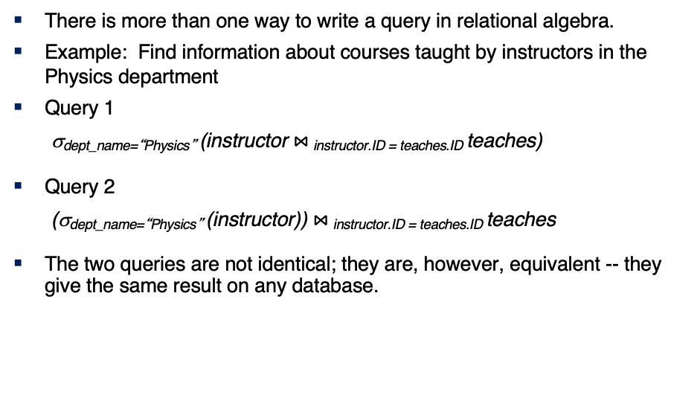
Equivalent Queries
There is more than one way to write a query in relational algebra.
Example: Find information about courses taught by instructors in the Physics department
Query 1
σ_{dept_name=“Physics”} (instructor $⋈_{ }$_{instructor.ID = teaches.ID} teaches)
Query 2
(σ_{dept_name=“Physics”} (instructor)) $⋈_{ }$_{instructor.ID = teaches.ID} teaches
The two queries are not identical; they are, however, equivalent -- they give the same result on any database.

Slide 33
What are all those other Symbols?
Some of the operators are useful and “common,” but not always considered part of the core algebra.
Some of these are pretty obscure
Division
Anti-Join
Left semi-join
Right semi-join
Most SQL engines do not support them.
You can implement them using combinations of JOIN, SELECT, WHERE, ... ...
But, I cannot every remember using them in applications I have developed.
Outer JOIN is very useful, but less common. We will cover.
There are also some “patterns” or “terms”
Equijoin
Non-equi join
Natural join
Theta join
... ...
I may ask you to define these terms on some exams or the obscure operatorsbecause they may be common internships/job interview questions.
τ order by
γ group by
¬ negation
÷ set division
⨝ natural join, theta-join
⟕ left outer join
⟖ right outer join
⟗ full outer join
⋉ left semi join
⋊ right semi join
▷ anti-join
Covered

Slide 34
Thinking about JOINs
Some terms:
Natural Join
Equality of A and B columns
With the same name.
Equijoin
Explicitly specify columns that must have the same value.
A.x=B.z AND A.q=B.w
Theta Join: Arbitrary predicate.
Inner Join
JOIN “matches” rows in A and B.
Result contains ONLY the matched pairs.
What is I want:
All the rows that matched.
And the rows from A that did not match?
OUTER JOIN (⟖, ⟕)
Covered

Slide 35
Do Some Joins
prereq is interesting
All courses with prereqs.
All courses and prereqs even if it does not have a prereq.
All courses and ones that are prereqs
Courses that do not have prereqs
Etc.
See notebook with examples.
Covered

Slide 36
Some Examples
A course and its prerequisites
π course_id←course.course_id,
course_title←course.title,
prerequisite_id←prereq.prereq_id,
prerequisite_title←p.course_id
(
(course ⨝ prereq)
⨝ prereq.prereq_id=p.course_id
ρ p(course))
Join course and prereq to get
course info
prereq_id
Join with
course using prereq_id
To get the prereq info
But,
course.course_id is ambiguous
Because the table appears twice.
So, I have to “alias” the second use.
Also, note the use of renaming in the project for column names.
Skip in class
But interesting

Slide 37
Some Examples
Courses-prerequisites and courses without prereqs.
τ prerequisite_id
(π course_id←course.course_id,
course_title←course.title,
prerequisite_id←prereq.prereq_id,
prerequisite_title←p.course_id
(
(course ⟕ prereq)
⟕ prereq.prereq_id=p.course_id
ρ p(course))
)
Skip in class
But interesting

Slide 38
Some Examples
Courses that are not prerequisites
τ prereq_course_id
(
π prereq_course_id←prereq.course_id,
course_id←course.course_id,
course_title←course.title
(
prereq ⟖ prereq_id=course.course_id course
)
)
Skip in class
But interesting

Slide 39
Relational Algebra
We will do more examples in lectures, HW assignments and exams.
The language is interesting but can be tedious and confusing.
Useful in some advanced scenarios:
Designing query languages for new databases and data models.
Understanding how DBMS implement query processing and optimization.
Also cover because it does come up in some advanced courses, and may come up in job interviews.
I give take home exams and homework assignments:
I cannot remember some of the more obscure operators.
You have to tinker with the expressions to get an answer.
Covered

Slide 40
SQL
40 | COMS W4111_002_2024_1: Lecture 3: ER, Relational, SQL (II) © Donald F. Ferguson, 2024

Slide 41
Assignment Rename
41 | COMS W4111_002_2024_1: Lecture 2: ER, Relational, SQL (II) © Donald F. Ferguson, 2024

Slide 42
The Rename Operation
Covered
The SQL allows renaming relations and attributes using the as clause:
old-name as new-name
Find the names of all instructors who have a higher salary than some instructor in 'Comp. Sci'.
select distinct T.name from instructor as T, instructor as S where T.salary > S.salary and S.dept_name = 'Comp. Sci.’
Keyword as is optional and may be omitted instructor as T ≡ instructor T
Notes:
9

Slide 43
NULL
43 | COMS W4111_002_2024_1: Lecture 2: ER, Relational, SQL (II) © Donald F. Ferguson, 2024

Slide 44
Codd’s 12 Rules
Rule 4: Active Online Catalog
The structure description of the entire database must be stored in an online catalog, known as data dictionary, which can be accessed by authorized users. Users can use the same query language to access the catalog which they use to access the database itself.
Rule 5: Comprehensive Data Sub-Language Rule
A database can only be accessed using a language having linear syntax that supports data definition, data manipulation, and transaction management operations. This language can be used directly or by means of some application. If the database allows access to data without any help of this language, then it is considered as a violation.
Rule 6: View Updating Rule
All the views of a database, which can theoretically be updated, must also be updatable by the system.
Rule 1: Information Rule
The data stored in a database, may it be user data or metadata, must be a value of some table cell. Everything in a database must be stored in a table format.
Rule 2: Guaranteed Access Rule
Every single data element (value) is guaranteed to be accessible logically with a combination of table-name, primary-key (row value), and attribute-name (column value). No other means, such as pointers, can be used to access data.
Rule 3: Systematic Treatment of NULL Values
The NULL values in a database must be given a systematic and uniform treatment. This is a very important rule because a NULL can be interpreted as one the following − data is missing, data is not known, or data is not applicable.

Slide 45
Codd’s 12 Rules
Rule 10: Integrity Independence
A database must be independent of the application that uses it. All its integrity constraints can be independently modified without the need of any change in the application. This rule makes a database independent of the front-end application and its interface.
Rule 11: Distribution Independence
The end-user must not be able to see that the data is distributed over various locations. Users should always get the impression that the data is located at one site only. This rule has been regarded as the foundation of distributed database systems.
Rule 12: Non-Subversion Rule
If a system has an interface that provides access to low-level records, then the interface must not be able to subvert the system and bypass security and integrity constraints.
Rule 7: High-Level Insert, Update, and Delete Rule
A database must support high-level insertion, updation, and deletion. This must not be limited to a single row, that is, it must also support union, intersection and minus operations to yield sets of data records.
Rule 8: Physical Data Independence
The data stored in a database must be independent of the applications that access the database. Any change in the physical structure of a database must not have any impact on how the data is being accessed by external applications.
Rule 9: Logical Data Independence
The logical data in a database must be independent of its user’s view (application). Any change in logical data must not affect the applications using it. For example, if two tables are merged or one is split into two different tables, there should be no impact or change on the user application. This is one of the most difficult rule to apply.

Slide 46
Codd’s 12 Rules
Rule 3: Systematic treatment of null values:
“Null values (distinct from the empty character string or a string of blank characters and distinct from zero or any other number) are supported in fully relational DBMS for representing missing information and inapplicable information in a systematic way, independent of data type.”
Sometimes programmers and database designers are tempted to use “special values” to indicate unknow, missing or inapplicable values.
String: “”, “NA”, “UNKNOWN”, ...
Numbers: -1, 0, -9999
Indicators can cause confusion because you have to carefully code some SQL statements to the specific, varying choices programmers made.

Slide 47
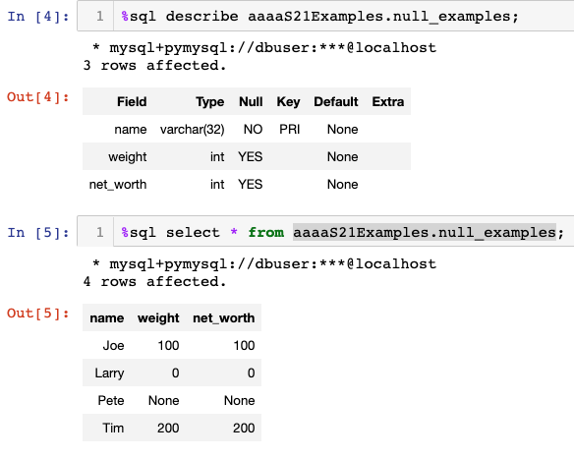
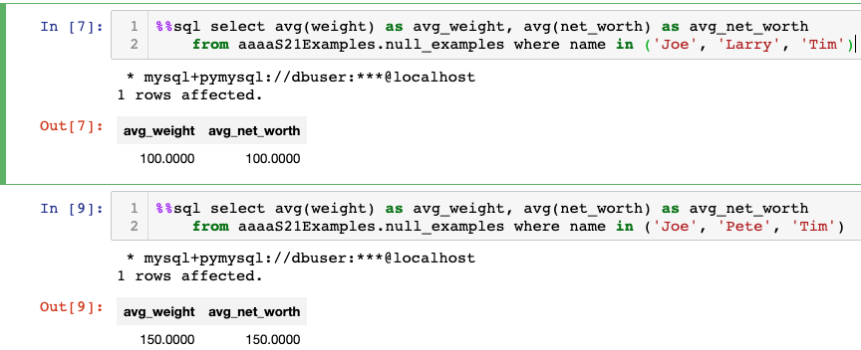
NULL and Correct Answers
Without NULL, to get a correct answer:
I must understand the domain to determine “unknown” values or know what choice a developer made.
Explicitly include “where weight != 0” in all statements.
And this varies from column to column, table to table, schema to schema, etc.

Slide 48
Null Values
It is possible for tuples to have a null value, denoted by null, for some of their attributes
null signifies an unknown value or that a value does not exist.
The result of any arithmetic expression involving null is null
Example: 5 + null returns null
The predicate is null can be used to check for null values.
Example: Find all instructors whose salary is null.
select name from instructor where salary is null
The predicate is not null succeeds if the value on which it is applied is not null.
Note:
NULL is an extremely important concept.
You will find it hard to understand for a while.

Slide 49
Null Values (Cont.)
SQL treats as unknown the result of any comparison involving a null value (other than predicates is null and is not null).
Example: 5 < null or null <> null or null = null
The predicate in a where clause can involve Boolean operations (and, or, not); thus the definitions of the Boolean operations need to be extended to deal with the value unknown.
and : (true and unknown) = unknown, (false and unknown) = false, (unknown and unknown) = unknown
or: (unknown or true) = true, (unknown or false) = unknown (unknown or unknown) = unknown
Result of where clause predicate is treated as false if it evaluates to unknown

Slide 50
Practice with Modifications
50 | COMS W4111_002_2024_1: Lecture 2: ER, Relational, SQL (II) © Donald F. Ferguson, 2024

Slide 51
Modification of the Database
Deletion of tuples from a given relation.
Insertion of new tuples into a given relation
Updating of values in some tuples in a given relation

Slide 52
Deletion
Delete all instructors
delete from instructor
Delete all instructors from the Finance department delete from instructor where dept_name= 'Finance’;
Delete all tuples in the instructor relation for those instructors associated with a department located in the Watson building.
delete from instructor where dept name in (select dept name from department where building = 'Watson');

Slide 53
Deletion (Cont.)
Delete all instructors whose salary is less than the average salary of instructors
Problem: as we delete tuples from instructor, the average salary changes
Solution used in SQL:
First, compute avg (salary) and find all tuples to delete
Next, delete all tuples found above (without recomputing avg or retesting the tuples)
delete from instructor
where salary < (select avg (salary)
from instructor);

Slide 54
Insertion
Add a new tuple to course
insert into course values ('CS-437', 'Database Systems', 'Comp. Sci.', 4);
or equivalently
insert into course (course_id, title, dept_name, credits) values ('CS-437', 'Database Systems', 'Comp. Sci.', 4);
Add a new tuple to student with tot_creds set to null
insert into student values ('3003', 'Green', 'Finance', null);

Slide 55
Insertion (Cont.)
Make each student in the Music department who has earned more than 144 credit hours an instructor in the Music department with a salary of $18,000.
insert into instructor select ID, name, dept_name, 18000 from student where dept_name = 'Music' and total_cred > 144;
The select from where statement is evaluated fully before any of its results are inserted into the relation.
Otherwise queries like
insert into table1 select * from table1
would cause problem

Slide 56
Updates
Give a 5% salary raise to all instructors
update instructor set salary = salary * 1.05
Give a 5% salary raise to those instructors who earn less than 70000 update instructor set salary = salary * 1.05 where salary < 70000;
Give a 5% salary raise to instructors whose salary is less than average
update instructor set salary = salary * 1.05 where salary < (select avg (salary) from instructor);

Slide 57
Updates (Cont.)
Increase salaries of instructors whose salary is over $100,000 by 3%, and all others by a 5%
Write two update statements:
update instructor set salary = salary * 1.03 where salary > 100000; update instructor set salary = salary * 1.05 where salary <= 100000;
The order is important
Can be done better using the case statement (next slide)

Slide 58
Aggregate Functions
58 | COMS W4111_002_2024_1: Lecture 2: ER, Relational, SQL (II) © Donald F. Ferguson, 2024

Slide 59
Aggregate Functions
Covered
These functions operate on the multiset of values of a column of a relation, and return a value
avg: average value min: minimum value max: maximum value sum: sum of values count: number of values
Note: Some database implementations have additional aggregate functions.

Slide 60
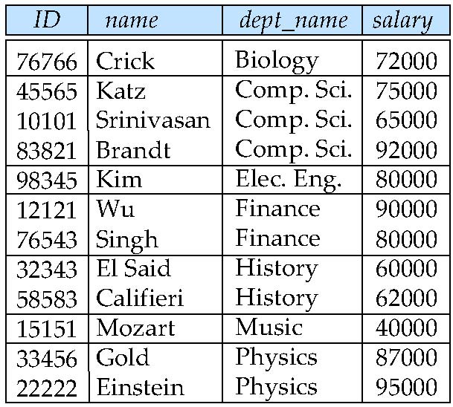
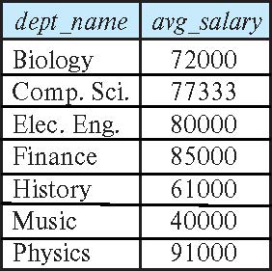
Aggregate Functions – Group By
Covered
Find the average salary of instructors in each department
select dept_name, avg (salary) as avg_salary from instructor group by dept_name;

Slide 61
Another View
GROUP BY column list
Forms partitions containing multiple rows.
All rows in a partition have the same values for the GROUP BY columns.
The aggregate functions
Merge the non-group by attributes, which may differ from row to row.
Into a single value for each attribute.
The result is one row per distinct set of GROUP BY values.
There may be multiple non-GROUP BY COLUMNS, each with its own aggregate function.
You can use HAVING in place of WHERE on the GROUP BY result.
Covered

Slide 62
Aggregate Functions Examples
Covered
Find the average salary of instructors in the Computer Science department
select avg (salary) from instructor where dept_name= 'Comp. Sci.';
Find the total number of instructors who teach a course in the Spring 2018 semester
select count (distinct ID) from teaches where semester = 'Spring' and year = 2018;
Find the number of tuples in the course relation
select count (*) from course;

Slide 63
Aggregation (Cont.)
Covered
Attributes in select clause outside of aggregate functions must appear in group by list
/* erroneous query */ select dept_name, ID, avg (salary) from instructor group by dept_name;

Slide 64
Aggregate Functions – Having Clause
Covered
Find the names and average salaries of all departments whose average salary is greater than 42000
Note: predicates in the having clause are applied after the formation of groups whereas predicates in the where clause are applied before forming groups
select dept_name, avg (salary) as avg_salary
from instructor
group by dept_name
having avg (salary) > 42000;

Slide 65
Fun with JOINs
65 | COMS W4111_002_2024_1: Lecture 3: ER, Relational, SQL (II) © Donald F. Ferguson, 2024

Slide 66
Joined Relations
Covered
Join operations take two relations and return as a result another relation.
A join operation is a Cartesian product which requires that tuples in the two relations match (under some condition). It also specifies the attributes that are present in the result of the join
The join operations are typically used as subquery expressions in the from clause
Three types of joins:
Natural join
Inner join
Outer join
Notes:
You will also hear terms like equi-join, non-equi-join, theta join, semi-join, ... ...
I ask for definitions on exams, but you can just look them up.

Slide 67
Natural Join in SQL
Covered
Natural join matches tuples with the same values for all common attributes, and retains only one copy of each common column.
List the names of instructors along with the course ID of the courses that they taught
select name, course_id from students, takes, where student.ID = takes.ID;
Same query in SQL with “natural join” construct
select name, course_id from student natural join takes;

Slide 68
Natural Join in SQL (Cont.)
Covered
The from clause can have multiple relations combined using natural join:
select A₁, A₂, … A_{n} from r₁ natural join r₂ natural join .. natural join r_{n} where P ;

Slide 69
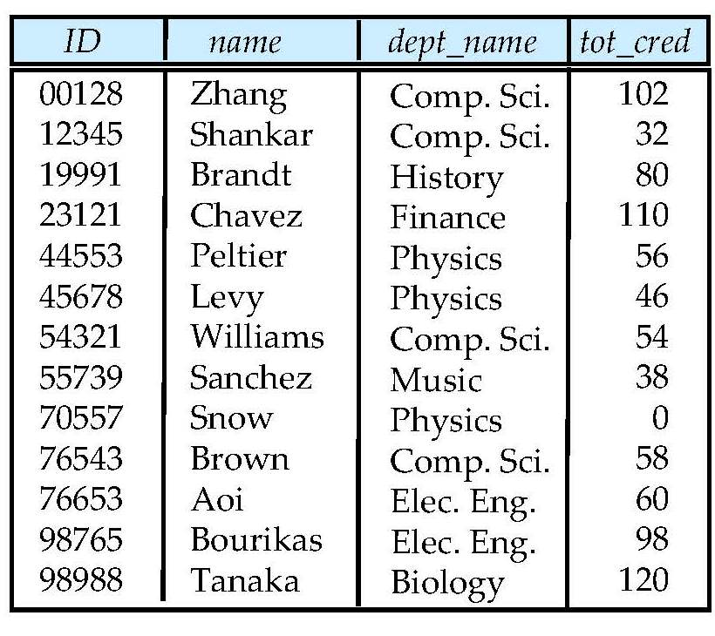
Student Relation
Covered

Slide 70
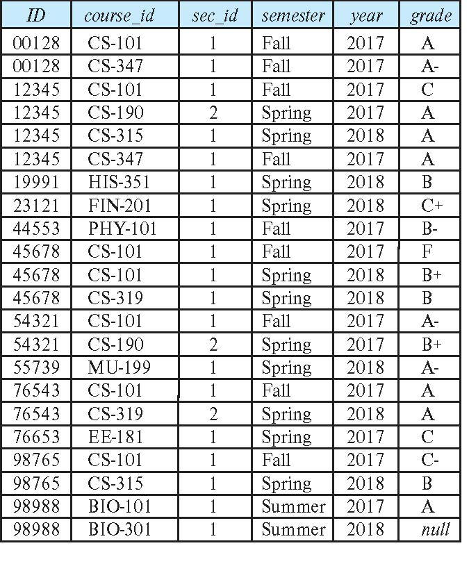
Takes Relation
Covered

Slide 71
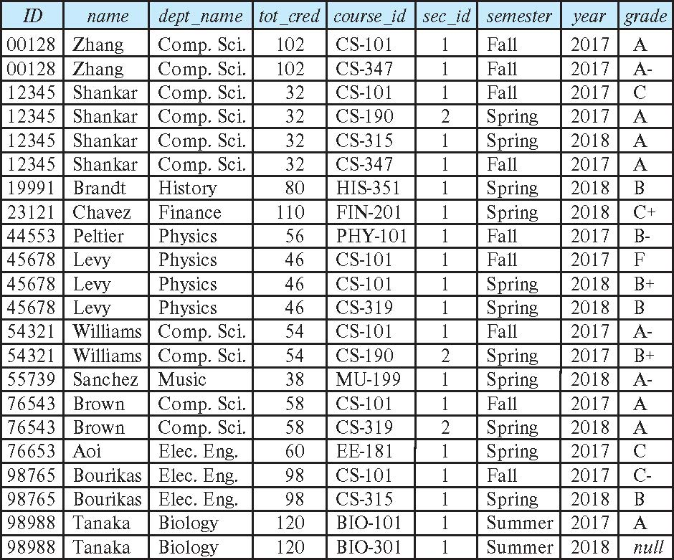
student natural join takes
Covered

Slide 72
Dangerous in Natural Join
Beware of unrelated attributes with same name which get equated incorrectly
Example -- List the names of students instructors along with the titles of courses that they have taken
Correct version
select name, title from student natural join takes, course where takes.course_id = course.course_id;
Incorrect version
select name, title from student natural join takes natural join course;
This query omits all (student name, course title) pairs where the student takes a course in a department other than the student's own department.
The correct version (above), correctly outputs such pairs.

Slide 73
Natural Join with Using Clause
Covered
To avoid the danger of equating attributes erroneously, we can use the “using” construct that allows us to specify exactly which columns should be equated.
Query example
select name, title from (student natural join takes) join course using (course_id)

Slide 74
Join Condition
To Cover
The on condition allows a general predicate over the relations being joined
This predicate is written like a where clause predicate except for the use of the keyword on
Query example
select * from student join takes on student_ID = takes_ID
The on condition above specifies that a tuple from student matches a tuple from takes if their ID values are equal.
Equivalent to:
select * from student , takes where student_ID = takes_ID

Slide 75
Join Condition (Cont.)
To Cover
The on condition allows a general predicate over the relations being joined.
This predicate is written like a where clause predicate except for the use of the keyword on.
Query example
select * from student join takes on student_ID = takes_ID
The on condition above specifies that a tuple from student matches a tuple from takes if their ID values are equal.
Equivalent to:
select * from student , takes where student_ID = takes_ID

Slide 76
One Way to Think About Joins
Covered

Slide 77
Examples in Notebook
Switch to Notebook

Slide 78
Examples
Web Application
Data Engineering Notebook
78 | COMS W4111_002_2024_1: Lecture 3: ER, Relational, SQL (II) © Donald F. Ferguson, 2024

Slide 79
Sample Projects
79 | COMS W4111_002_2024_1: Lecture 3: ER, Relational, SQL (II) © Donald F. Ferguson, 2024

Slide 80
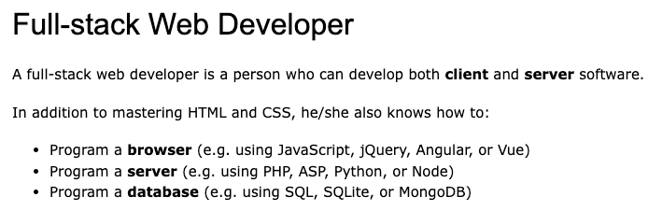
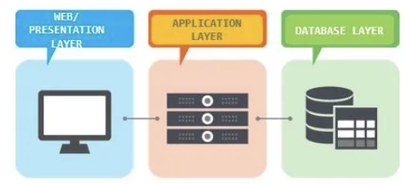
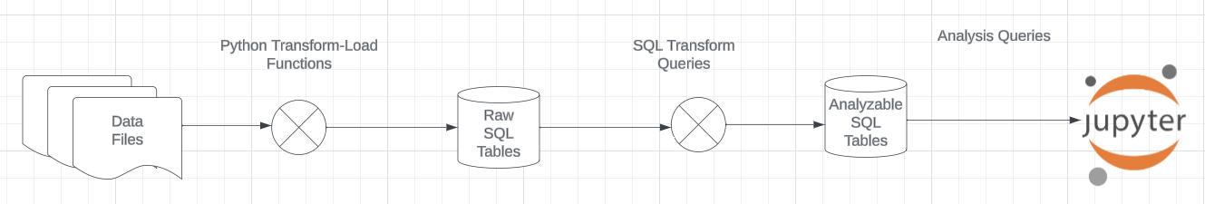
Projects
The programming track will implement a simple, full stack web application.
The non-programming track will implement a data engineering and visualization process in a Jupyter notebook.

Slide 81
Sample Projects
Walkthrough of Web Apps:
/Users/donaldferguson/Dropbox/000/000-A-Current-Examples/W4111-FastAPI-IMDB-Solution
/Users/donaldferguson/Dropbox/000/000-A-Current-Examples/current-dashboard
Data Engineering:
/Users/donaldferguson/Dropbox/000/000-Columbia/2024-Spring/W4111-Intro-to-Databases-Spring-2024/Lectures/s-2024-Lecture-3/More-Data-Engineering.ipynb
And others.

Slide 82
The End for Today
82 | COMS W4111_002_2024_1: Lecture 3: ER, Relational, SQL (II) © Donald F. Ferguson, 2024

